Slide 1
Interconnections of sport

Slide 2
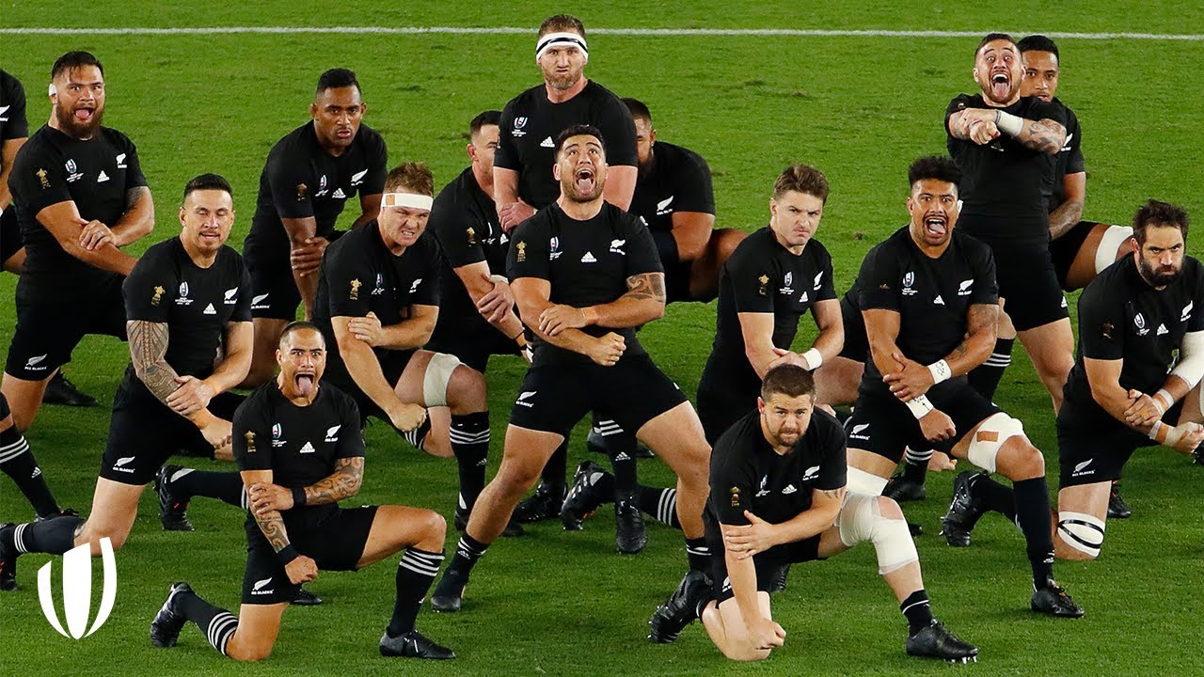

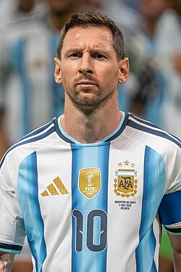
Advantages of globalization of sport
What are some of the advantages of the globalisation of sport? Use at least 2, and refer to specific examples.
Plan here, use the advantages you circled:
Advantage type | Advantage | Example
Sociocultural | Greater cultural exchange | The All Blacks Haka – spreading Maori culture.
Competitive advantage | Opportuntiy for atheletes | Soccer players move to European academies and improve their skills, such as Messi to Barcelona

Slide 3
How to answer…
The globalisation of sport has many sociocultural advantages, such as the increase in cultural exchange and providing competitive advantages. Sporting events give an opportunity for different cultures to share their traditions and customs on the international stage, fostering an international exchange of ideas and respect. For example, the New Zealand All Blacks Rugby Union Team perform the famous Haka (a traditional war-dance) before games, which is an opportunity for share the indigenous Maori culture with international audiences.
Additionally, the globalisation of sports provides competitive advantages. European football teams such as Barcelona often scout talented players from across the world to find and develop them into the next superstars. These academies provide opportunities for players to improve their skills and progress their career, as was the case with Lional Messi from Argentina, who joined Barcelona’s academy at 13 and developed into one of the best players of all time.
State
Explain
Example
State
Explain
Example

